Slide 1

Patients Attending Medical Appointments
Exploratory Data Analysis (EDA)
Abdulelah Ibrahim Aldossari

Slide 2
Objects
1. Introduction
2. Data Cleaning and Preparation
3. Data Visualization
4. Conclusion

Slide 3
Introduction
What is the dataset?

Slide 4
Introduction
What are the Data Features?
Appointment ID | Patient ID
Scheduled Day | Gender
Age | Appointment Day
Scholarship | Neighborhood
Diabetes | Hypertension
Handicap | Alcoholism
No-show | SMS_received

Slide 5
Introduction
Questions should be answered
What are the top three features affecting patients' attendance for their appointments?
Is there a correlation between one feature and another?
What do you suggest to solve this problem?

Slide 6
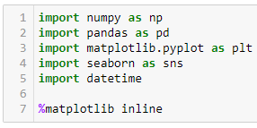
Data Cleaning and Preparation
Libraries Used

Slide 7
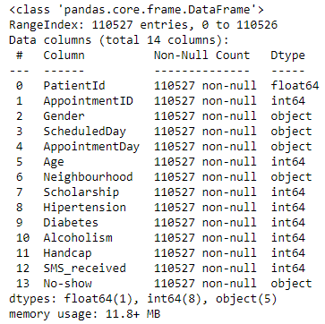
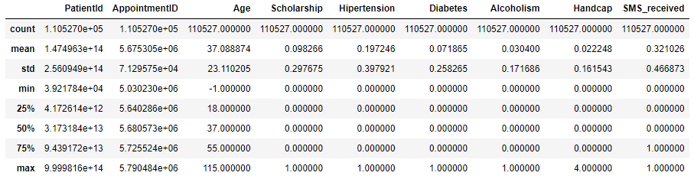
Data Cleaning and Preparation
Summary and statistical information

Slide 8
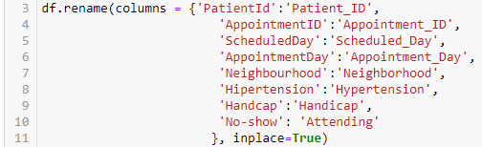
Data Cleaning and Preparation
Change the column names to clearer names

Slide 9
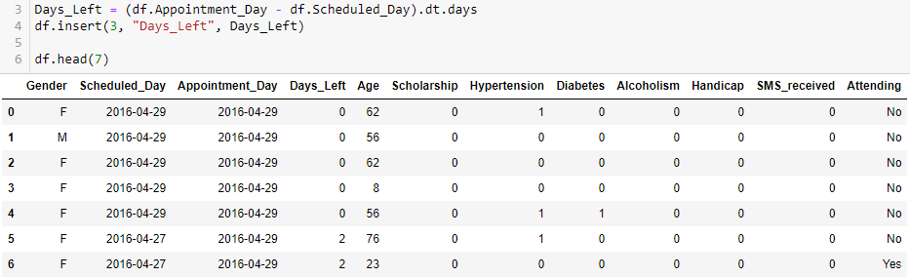
Data Cleaning and Preparation
Calculating how many days left

Slide 10
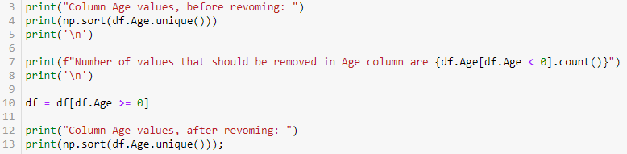
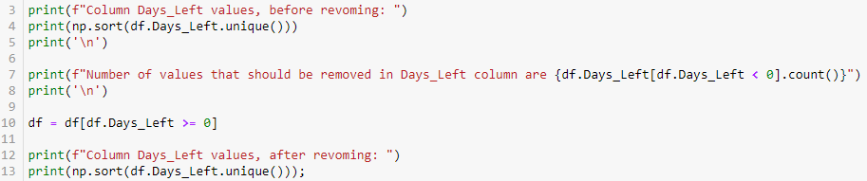
Data Cleaning and Preparation
Remove irrational values in the columns Age and Days_Left

Slide 11
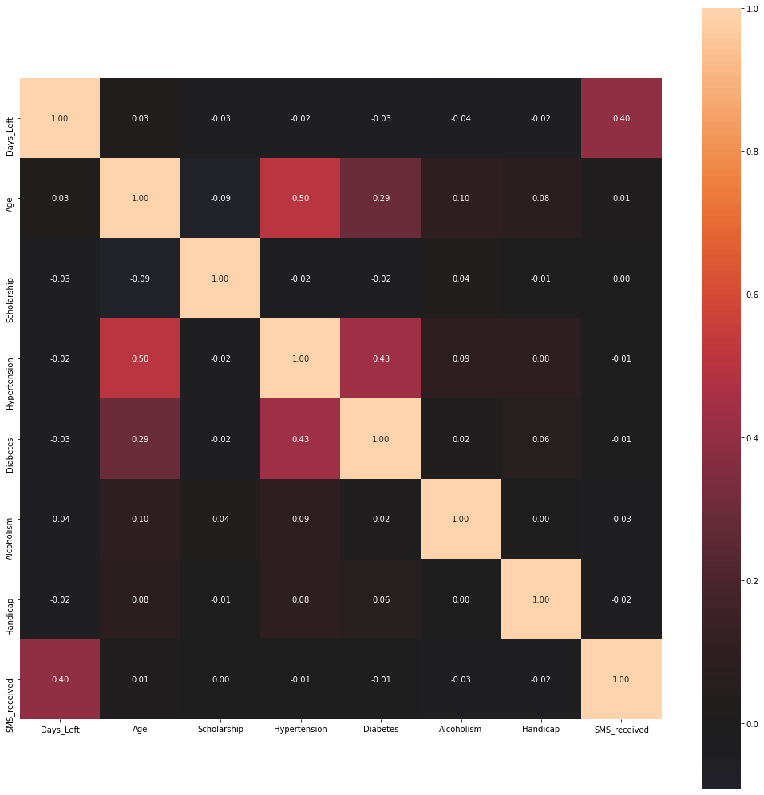
Data Visualization
Correlation between features

Slide 12
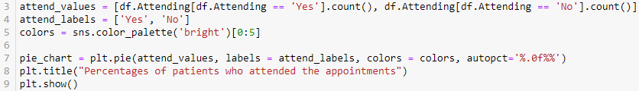
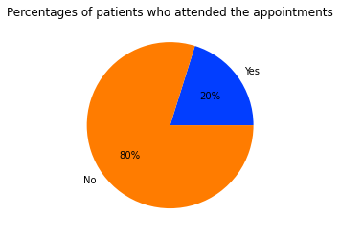
Data Visualization
Percentage of patients who attended the appointments

Slide 13
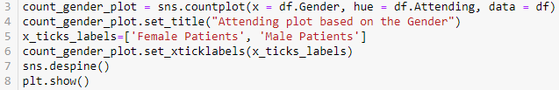
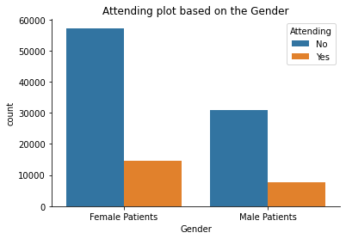
Data Visualization
Number of male and female patients who attended the appointments

Slide 14

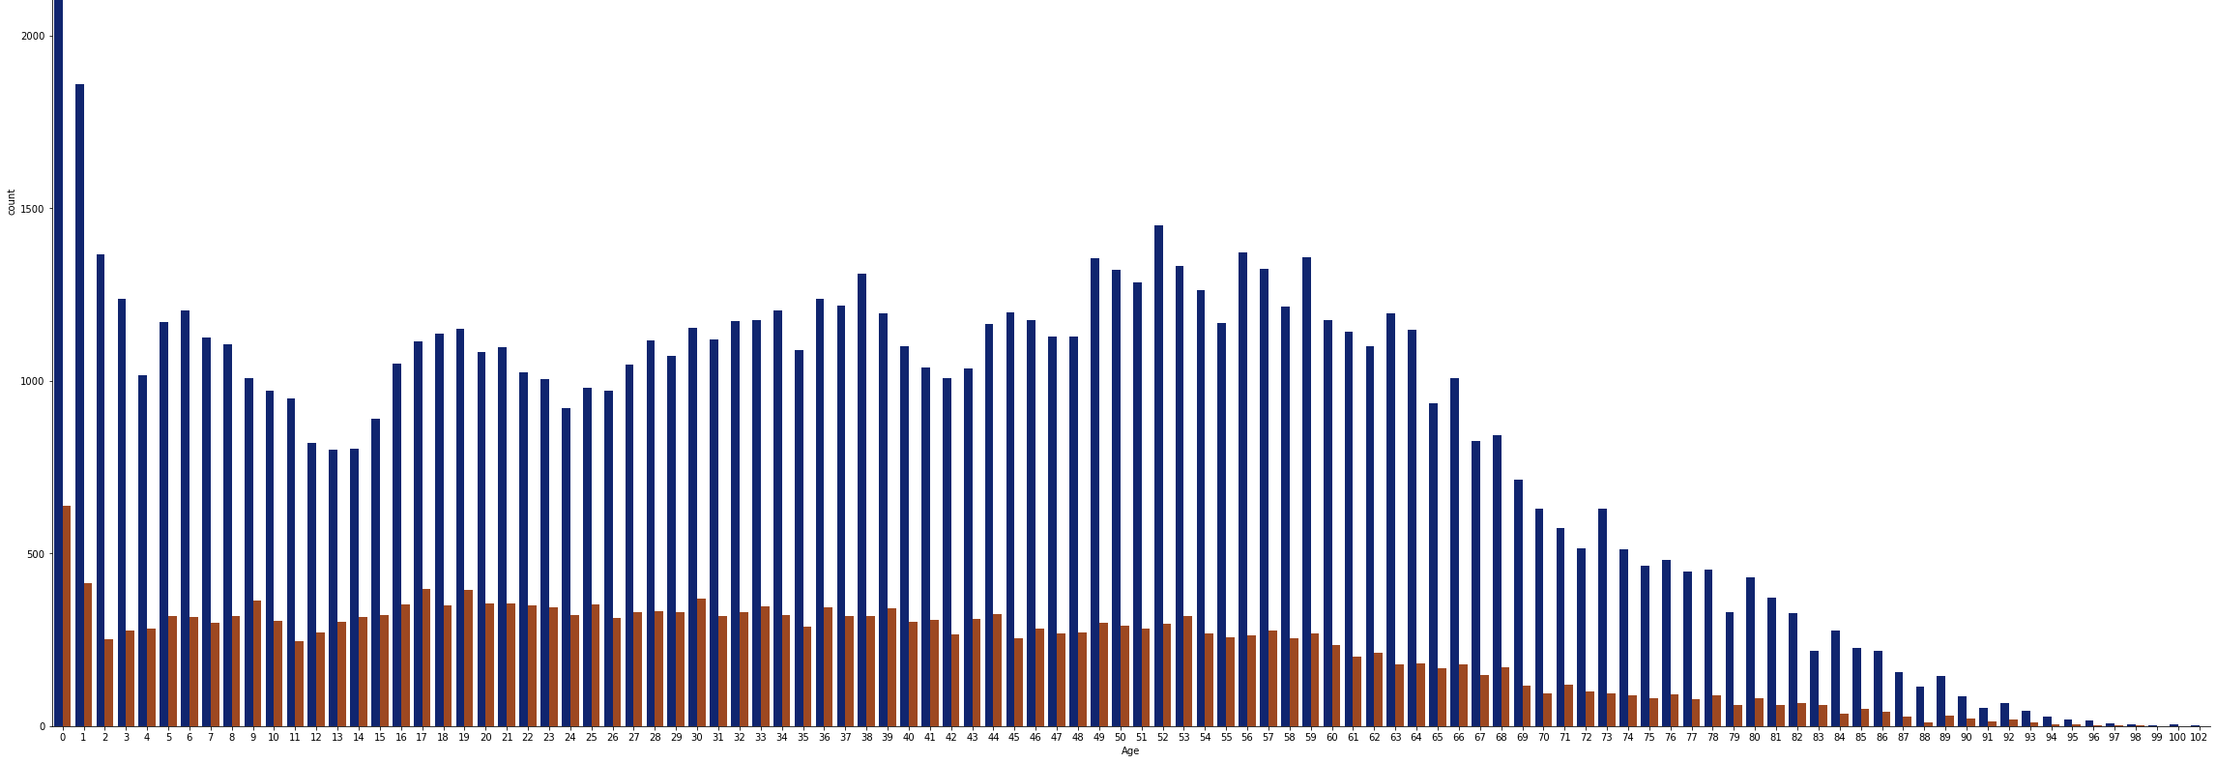
Data Visualization
Comparing Age with number of patients

Slide 15

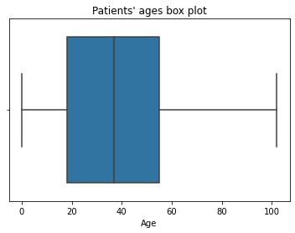
Data Visualization
Patients' ages in the form of box plot

Slide 16
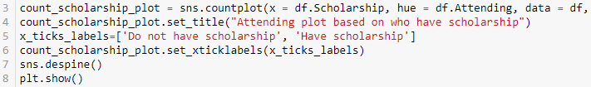
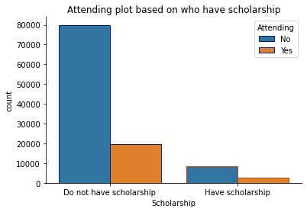
Data Visualization
Comparing having Scholarship with number of patients

Slide 17
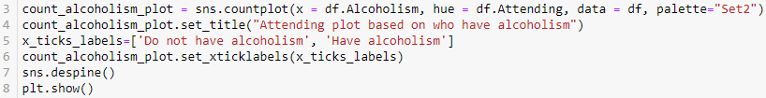
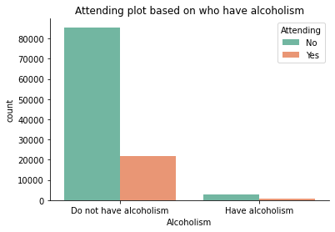
Data Visualization
Comparing having Alcoholism with number of patients

Slide 18
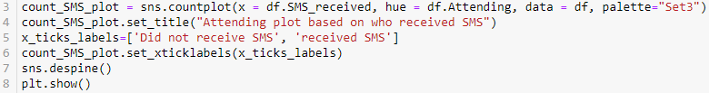
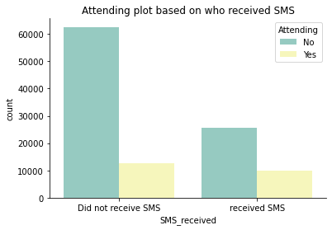
Data Visualization
Comparing Receiving SMS with number of patients

Slide 19
Conclusion
What are the top three features affecting patients' attendance for their appointments?
1. Alcoholism
2. Scholarship
3. Gender

Slide 20
Conclusion
Is there a correlation between one feature and another?
- Age and Hypertension
- Diabetes and Hypertension
- Days_Left and SMS_received

Slide 21
Conclusion
What do you suggest to solve this problem?
- Age
- Scholarship
- Alcoholism
- SMS_received

